Slide 1

Introduction to libSBOL (C++) & pySBOL (Python) Bryan Bartley bartleyba@sbolstandard.org The Sauro Systems & Synthetic Biology Lab University of Washington, Seattle, WA

Slide 2
Features in v2.3.0b
Read and write SBOL files
Interface with online validation tool
Interface with SynBioHub repository
Design abstraction
Hierarchical sequence assembly
Biosystem design (modules & interactions)
Extensible data model and custom annotations
Experimental classes for representation of combinatorial libraries and versioning histories

Slide 3
Python Code is Generated from C++
Code generation
Compilation
Extra plumbing
libSBOL
(.cpp)
Wrapper code
(.cxx)
Python extension library (.so, .dll)
pySBOL module
(.py)
LibSBOL can be translated into other languages implemented in C/C++ as well (eg, Matlab)
API is consistent across different languages
Serialization is defined and predictable (ideal for a standard language such as SBOL!)

Slide 4
LibSBOL Installation
LibSBOL is implemented in C++11 and compiles on MacOSX, Windows, and Linux. Uses CMake meta-build tool
Homepage:
http://synbiodex.github.io/libSBOL
or link from
http://sbolstandard.org
Software -> Libraries -> C++

Slide 5
LibSBOL Installation
For installation options, see: http://synbiodex.github.io/libSBOL/installation.html
Build from source (currently v2.3b)
Install using Windows binary installers (currently v2.2.1)
Install using Brew brew package distribution for Mac OS X(currently v2.2.1

Slide 6
PySBOL Installation
PySBOL is implemented in Python 2.7 and 3.6 on Windows and Mac OSX
Homepage:
https://pysbol2.readthedocs.io/en/latest/
or link from
http://sbolstandard.org
Software -> Libraries -> Python

Slide 7
PySBOL Installation
For installation options, see: http://synbiodex.github.io/libSBOL/installation.html
Build from Source (currently v2.3b)
Install using Windows binary installers (currently v2.2)
Install using pip packages (currently v2.3b)

Slide 8
Guiding Philosophy
User-experience: An object-oriented approach to synthetic biology
Library implementation and specification diagrams are intuitively correlated
Extensible data model

Slide 9
User Experience

Slide 10
Synthetic Biology Should Be a Joyful Act of Creation

Slide 11
Object-oriented Synthetic Biology
Synthetic biologists need to re-use and share DNA sequences in the same way that programmers re-use and share software components.
Synthetic biologists need to assemble modular systems
Synthetic biology needs an OOP framework for design abstraction.
Notes:
SBOL closely tied to software use-cases and data exchange.
What are the key concepts and ideas that use when imagining a design. What are the actions I want to perform on those objects
Close mapping between the standard, libraries, and the domain knowledge representation

Slide 12
Object-oriented Synthetic Biology
LibSBOL’s API uses a noun-verb syntax:
EYFP_production.participations.create (C++)
vs
EYFP_production.createParticipation (Java)
Think about the data model first, then act.
Notes:
SBOL closely tied to software use-cases and data exchange.
What are the key concepts and ideas that use when imagining a design. What are the actions I want to perform on those objects
Close mapping between the standard, libraries, and the domain knowledge representation

Slide 13
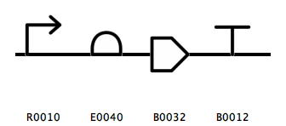
High-level Design Automation
Assemble hierarchical DNA constructs and template designs
Compile DNA sequences from different parts; replace cut-and-paste
Assemble modules, eg, layered, regulatory gates and other modular systems
gene_example
Notes:
Why use SBOL not genbank?
Assemble template design first
Template designs specify general function using SO type not sequences
- Researcher might want a template and then instantiate different variants of the design
Researcher might not want to disclose information
Researcher might simply want a visual diagram of a circuit’s function

Slide 14
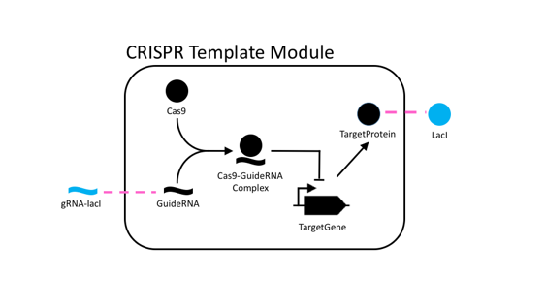
Other High-level Design Tasks
Connecting Module Inputs and Outputs
Mechanistic Modeling of Biochemical Interactions
Overriding Components in a Template Design

Slide 15
SBOL Integrates Data Across Networks
Every SBOL data object has a uniform resource identifier (URI).

Slide 16
Every SBOL Objects has a Uniform Resource Identifiers (URI).
http://sys-bio.org/my_design/1.0.0
scheme
namespace
displayId
version

Slide 17
An Example Constructor
Sets default namespace for URI generation
setHomespace("http://sys-bio.org");
ComponentDefinition& TargetPromoter = *new ComponentDefinition
("TargetPromoter", BIOPAX_DNA);
TargetPromoter.roles.set(SO_PROMOTER)

Slide 18
An Example Constructor
The identifier for the URI.
In SBOL-compliant mode, this also sets the object’s displayId
setHomespace("http://sys-bio.org");
ComponentDefinition& TargetPromoter = *new ComponentDefinition
("TargetPromoter", BIOPAX_DNA)
TargetPromoter.roles.set(SO_PROMOTER)

Slide 19
An Example Constructor
After the identifier, comes 0 or more required fields. For ComponentDef’s
molecular type is required
setHomespace("http://sys-bio.org");
ComponentDefinition& TargetPromoter = *new ComponentDefinition
("TargetPromoter", BIOPAX_DNA);
TargetPromoter.roles.set(SO_PROMOTER)

Slide 20
An Example Constructor
setHomespace("http://sys-bio.org");
ComponentDefinition& TargetPromoter = *new ComponentDefinition
("TargetPromoter", BIOPAX_DNA);
TargetPromoter.roles.set(SO_PROMOTER)
Optional fields are set after construction

Slide 21
An Example Constructor
setHomespace("http://sys-bio.org");
ComponentDefinition& TargetPromoter = *new ComponentDefinition
("TargetPromoter", BIOPAX_DNA);
TargetPromoter.roles.set(SO_PROMOTER)
Some programmer’s might regard this syntax as bad form.
For a justification why I use this syntax, see: http://synbiodex.github.io/libSBOL/getting_started.html#idiomatic_cpp
Then send hate-mail to sbol-editors@googlegroups.com!

Slide 22
See Getting Started with SBOL Documentation

Slide 23
Library Implementation and Specification Document are Closely Correlated

Slide 24
From Specification Diagram to Class Definition
namespace sbol
{
class ComponentDefinition : public TopLevel
{
public:
URIProperty types;
URIProperty roles;
ReferencedObject sequences;
List<OwnedObject<SequenceAnnotation>> sequenceAnnotations;
List<OwnedObject<Component>> components;
List<OwnedObject<SequenceConstraint>> sequenceConstraints;
…
}

Slide 25
An Important “Gotcha!”
The incorrect, but more intuitive way:
component_def.sequences.add( seq_object );
The correct, but more intuitive way:
component_def.sequences.add( seq_object.identity.get() );

Slide 26
Validation Rules Cross-Reference to the Spec Document and are Easily Extensible
Identified(sbol_type type = UNDEFINED, std::string uri_prefix = SBOL_URI, std::string id = “Identified/example”) :
identity(SBOL_IDENTITY, this, uri_prefix + "/" + id, ”,
validation_rules = { sbol_rule_10202 })
{
};

Slide 27
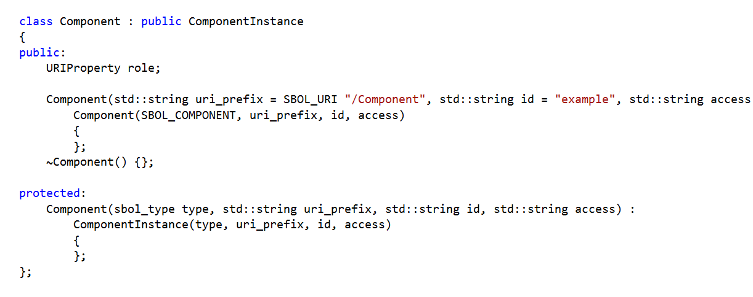
Easy to Implement Future Enhancements in the SBOL Data Model
SBOL 2.0.0

Slide 28
Easy to Implement Future Enhancements in the SBOL Data Model
SBOL 2.0.1

Slide 29
Extensible Data Model

Slide 30
Custom Annotations
component_def.setAnnotation(“http://sys-bio.org#emission_wavelength”, “450”);

Slide 31
SBOL Extensions Add New Classes to the Data Model
SBOL Core Data Model
SBOL Extension Data Model
DiCOM-SB Data Model
Read & Write in SBOL File Format

Slide 32
Some Example Extensions
Design-build-test
Extension
Host context
Extension
3D Structure
Extension

Slide 33
1
Data exchange with libSBOL (C++) extensions
Host(ModuleDefinition)
.h
.h
Host(ModuleDefinition)
<host_context:Host>
C++
.sbol
C++/Java
Data exchange with generic annotations
2
Host(ModuleDefinition)
GenericTopLevel()
.h
<host_context:Host>
C++
.sbol
C++/Java

Slide 34
Host Context Extension
#define EXTENSION_PREFIX "host_context"
#define EXTENSION_NS "sys-bio.org/HostContext#"
#define EXTENSION_CLASS "Host"
class Host : public ModuleDefinition
{
Host(sbol_type type, std::string uri) :
ModuleDefinition(type, uri),
modules(EXTENSION_NS "modules", this),
parents(EXTENSION_NS "parents", this),
children(EXTENSION_NS "children", this),
generation(EXTENSION_NS "generation", this, 1),
medium(EXTENSION_NS "medium", this, "www.ebi.ac.uk/efo/EFO_0000579"),
vendorId(EXTENSION_NS "vendorId", this, "sigmaaldrich.com/L2542")
{
register_extension < Host > (EXTENSION_PREFIX, EXTENSION_NS EXTENSION_CLASS);
};
}

Slide 35
Host Context Serialization
<?xml version="1.0" encoding="utf-8"?>
<rdf:RDF xmlns:dcterms="http://purl.org/dc/terms/#"
xmlns:host_context="sys-bio.org/HostContext#"
xmlns:prov="http://www.w3.org/ns/prov#"
xmlns:rdf="http://www.w3.org/1999/02/22-rdf-syntax-ns#"
xmlns:sbol="http://sbols.org/v2#">
<host_context:Host rdf:about="sys-bio.org/BB1">
<sbol:persistentIdentity rdf:resource="sys-bio.org/BB1"/>
<host_context:generation>1</host_context:generation>
<host_context:medium rdf:resource="www.ebi.ac.uk/efo/EFO_0000579"/>
<host_context:vendorId>sigmaaldrich.com/L2542</host_context:vendorId>
</host_context:Host>
<sbol:ModuleDefinition rdf:about="sys-bio.org/CRISPRTemplate">
<sbol:persistentIdentity rdf:resource="sys-bio.org/CRISPRTemplate"/>
</sbol:ModuleDefinition>
<sbol:ModuleDefinition rdf:about="sys-bio.org/CRPbCircuit">
<sbol:persistentIdentity rdf:resource="sys-bio.org/CRPbCircuit"/>
</sbol:ModuleDefinition>
</rdf:RDF>

Slide 36
Concluding Remarks

Slide 37
pySBOL API
API closely resembles C++ API with a few exceptions:
No new operator required for object constructions
No templated methods, thus:
doc.get<ComponentDefinition>() becomes doc.getComponentDefinition()
Use lists instead of vectors
If you have trouble finding documentation of certain methods in Python, try using the C++ API reference and methods

Slide 38
Tutorial Exercises:
See the following library documentation pages:
Getting started with SBOL for a basic introduction to library API
Biological parts repositories
Sequence assembly (structural representation)
Biosystem design (functional representation)
Notes:
What is the template? What do the mappings means
Work in pairs, break down into tasks you are most interested in
Pair biologist with developers

Slide 39
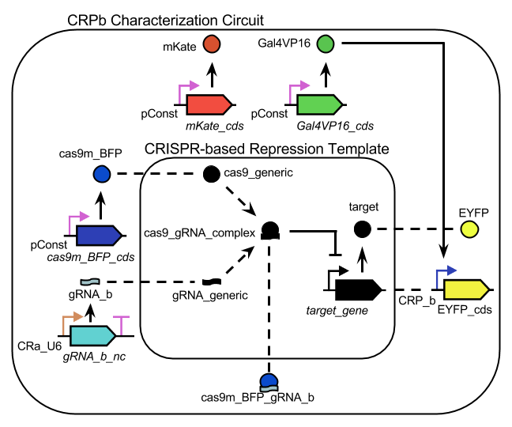
Tutorial Exercises: CRISPR Characterization Circuit
sbolstandard.org -> Software -> Libraries -> C/C++ -> CRISPR Circuit Example
Notes:
What is the template? What do the mappings means
Work in pairs, break down into tasks you are most interested in
Pair biologist with developers

Slide 40
Tutorial Exercises: Convert CRISPR Plasmid to SBOL
https://www.addgene.org/46569/
Notes:
What is the template? What do the mappings means
Work in pairs, break down into tasks you are most interested in
Pair biologist with developers

Slide 41
Tutorial Exercises: Conversion of Cello Parts (JSON) to SBOL
Notes:
What is the template? What do the mappings means
Work in pairs, break down into tasks you are most interested in
Pair biologist with developers

Slide 42

Please try out!

Slide 43
Acknowledgements
Kiri Choi
PhD Student
Anil Wipat and the Newcastle team
Chris Myers and the Utah team
The SBOL Editors
NSF Collaborative awards #1355909
Kyle Medley
PhD Student
Herbert Sauro,
Associate Professor of Bioengineering

Slide 44
LibSBOL Also Supports a More “Open-world” Approach to Object Creation
Few restrictions placed on URIs.
Constructors are primary means of creating objects.
Objects can be manipulated independent from an SBOL Document.
Emphasizes other uses of Data Model for knowledge representation and computational biology. See my upcoming talk Version and Variant Control for Synthetic Biology at COMBINE 2016
For today’s tutorial, open-world approach should be avoided!

